Slide 1
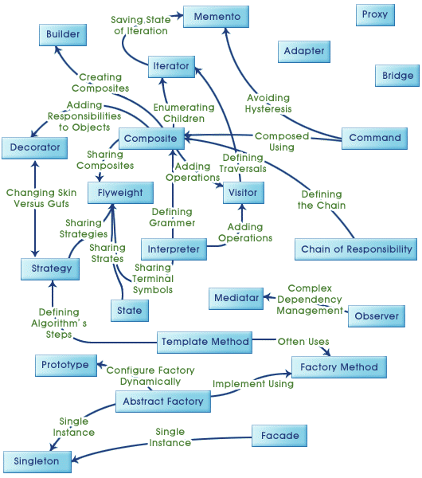

Design Patterns in Java
M. DORRA
SoftwareDeveloper implements SoftwareEngineer
R&D-AIR-MCT-LOY-COM-FD4
Notes:
Cover example with no photos
To update the text, just click on the text
To get more slides with this layout just copy this slide and paste

Slide 2
Agenda
Why software rots?!
  Design smells
Solid Principles
Design Patterns
  What and Why are they?
  Gang Of Four
  Principles
  Creational
  Structural
  Behavioural
Notes:
Please read these useful tips before you start using this template
Remove this slide when your PPT is ready

Slide 3
Why software rots?!
Only one thing is constant in software field and it is
“CHANGE"
The Copy Example
Environment change(s)
Copy
Read Keyboard
Write Printer
Unused code
Rarely updated code
So?
Refactoring
Or Microsoft’s solution
Notes:
Cover example with photo inside the shape
Insert new photo: Click on Insert photo-icon on slide and Insert new photo
Use Crop Tool under Picture Tools to pan and zoom
Beware: when you add or replace a picture, it may come to the front. Right click on it and select ‘Send to back’ to re-arrange it.
To update the text, just click on the text
To get more slides with this layout just copy this slide and paste

Slide 4
Design smells
Rigidity. The design is difficult to change.
Fragility. The design is easy to break.
Immobility. The design is difficult to reuse.
Viscosity. It is difficult to do the right thing.
Needless complexity. Overdesign.
Needless repetition. Mouse abuse.
“singleton java” -site:stackoverflow.com
Opacity. Disorganized expression.
Notes:
Divider example with photo
Insert new photo: Click on Insert photo-icon on slide and Insert new photo
Use Crop Tool under Picture Tools to pan and zoom
To update the text, just click on the text
To get more slides with this layout just copy this slide and paste

Slide 5
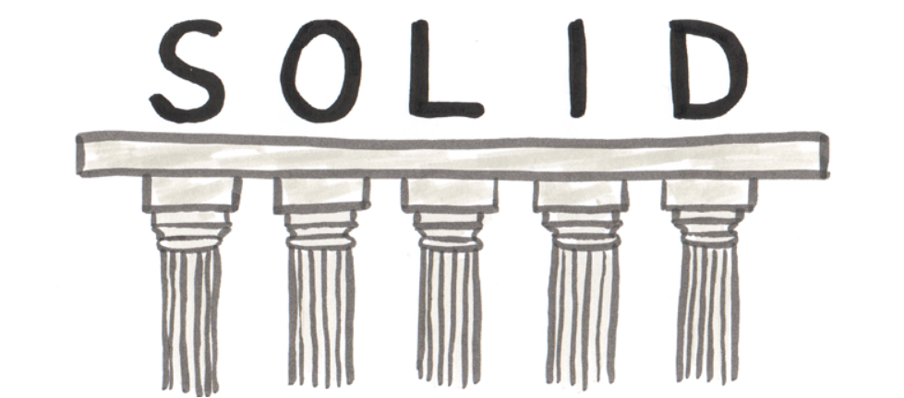
© Amadeus IT Group and its affiliates and subsidiaries
Notes:
Divider example with no photo
To update the text, just click on the text
You can change the colour to Amadeus Blue or Amadeus Light blue if needed
To get more slides with this layout just copy this slide and paste

Slide 6
Solid principles
S.R.P
Single responsibility principle
A class should have only one reason to change.
interface MembershipService{
void registerMember(Member member);
void calculateProfileCompleteness(Member member);
… other responsibilities
}
class MembershipServiceImpl implements MembershipService{
@Inject SomeServive1 service1;
@Inject SomeServive2 service2;
@Inject SomeServive3 service3;
@Inject SomeServive4 service4;
…. A lot of injections
}

Slide 7
Solid principles
O.C.P
Open / closed principle
Software entities (classes, modules, functions, etc.) should be open for extension but closed for modification.
But HOW ?! seems that these two attributes are at odds.
Simple answer.. ABSTRACTION

Slide 8
Solid principles
L.S.P
Liskov substitution principle
Subtypes must be substitutable for their base types.
Functions that use pointers of references to base classes must be
able to use objects of derived classes without knowing it.

Slide 9
Solid principles
L.S.P
Liskov substitution principle
interface Membership {
void setName(String name);
void setDocuments(List<Document> docs);
List<Document> getDocuments();
}
class Individual implements Membership {
void setName(String name){}
void setDocuments(List<Document> docs){
this.documents = docs;
}
}
class Organization implements Membership {
void setName(String name){}
void setDocuments(List<Document> docs){
// Oops, I don’t need documents
}
}

Slide 10
Solid principles
L.S.P
Liskov substitution principle
class Test{
void testDocuments(Membership membership){
assertNotEmpty(membership.getDocuments());
}
void doTest(){
Membership membership = new Individual();
membership.setDocuments(Arrays.asList(new Document()));
testDocuments(membership);
membership = new Organization();
membership.setDocuments(Arrays.asList(new Document(), new Document()));
testDocuments(membership); ??
}
}

Slide 11
Solid principles
I.S.P
Interface segregation principle
Clients should not be forced to depend on methods they do not use.
interface Membership {
void setName(String name);
void setDocuments(List<Document> docs);
}
class Individual implements Membership {
void setName(String name){}
void setDocuments(List<Document> docs){
this.documents = docs;
}
}
class Organization implements Membership {
void setName(String name){}
void setDocuments(List<Document> docs){
// Oops, I don’t need documents
}
}

Slide 12
Solid principles
I.S.P
Interface segregation principle
interface Membership {
void setName(String name);
}
interface WithDocuments{
void setDocuments(List<Document> docs);
}
class Individual implements Membership, WithDocuments{
void setName(String name){}
void setDocuments(List<Document> docs){
this.documents = docs;
}
}
class Organization implements Membership{
void setName(String name){}
}

Slide 13
Solid principles
D.I.P
Dependency inversion principle
High-level modules should not depend on low-level modules.
Both should depend on abstractions.
Abstractions should not depend upon details. Details should
depend upon abstractions.

Slide 14
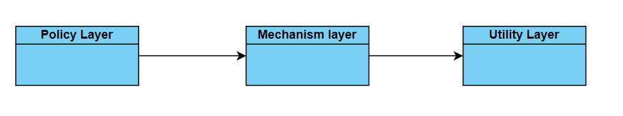
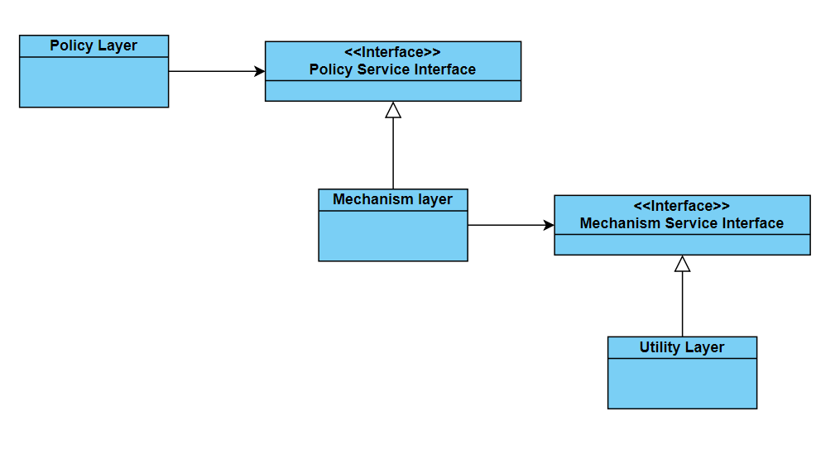
Solid principles
D.I.P
Dependency inversion principle
Ownership Inversion
Dependence on Abstractions
No variable should hold a reference to a concrete class.
No class should derive from a concrete class.
No method should override an implemented method of any of its base classes.

Slide 15

Thinking in Patterns
Confidential
RESTRICTED
Notes:
Cover example with photo as background
Insert new photo: Click on Insert photo-icon on slide and Insert new photo
Right-click on photo and choose ‘Send to Back’ to have the shape visible again.
Use Crop Tool under Picture Tools to pan and zoom
Beware: when you add or replace a picture, it may come to the front. Right click on it and select ‘Send to back’ to re-arrange it.
To update the text, just click on the text
To get more slides with this layout just copy this slide and paste

Slide 16
What are design patterns? Why !
Solutions to general problems that software developers faced during software development. These solutions were obtained by trial and error by numerous software developers over quite a substantial period of time.
Represent the best practices used by experienced object-oriented software developers
Gang Of Four (GOF)
[GOF95] Erich Gamma, Richard Helm, Ralph Johnson, and John Vlissides, Design Patterns: Elements of Reusable Object-Oriented Software, Addison-Wesley, 1995.

Slide 17

Simple principles
Program to an interface, not an implementation.
Favor object composition over class inheritance.

Slide 18
Categories
Creational
Abstracts the instantiation process
Structural
How classes and objects are composed to form larger structures.
Behavioral
Algorithms and the assignment of responsibilities ,flow and communications between classes or objects

Slide 19
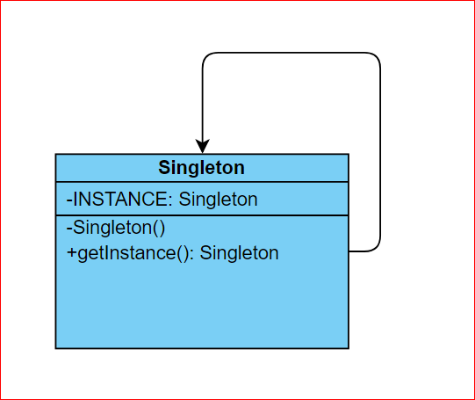
Singleton
Ensure a class only has one instance, and provide a global point of access to it.

Slide 20
Singleton
Lazy initialization
Multithreaded environment
Double locking
Serialization / Deserialization

Slide 21
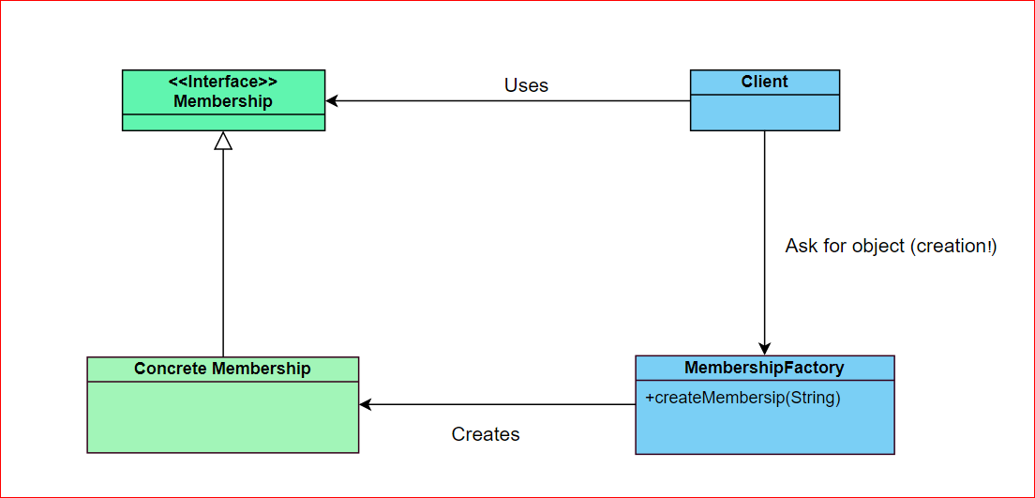
Factory
Provide an interface for creating objects without specifying their concrete classes.

Slide 22

Factory
public class TierFactory{
public Tier create(String type){
if(type == “blue”)
return new Blue();
if(type == “silver”)
return new Silver();
….
}
}
Broken principle
OCP

Slide 23
Factory
public class TierFactory{
Map<String, Class<Tier>> registeredTiers = …;
public void registerTierType(String type, Class<Tier>> tierClass){
registeredTiers.put(type, tierClass);
}
public Tier create(String type){
Class tierClass = (Class) registeredTiers.get(type);
Constructor tierConstructor = tierClass.getDeclaredConstructor(…);
return (Tier) tierConstructor.newInstance(…);
}
}
Reflection!! Other options?

Slide 24
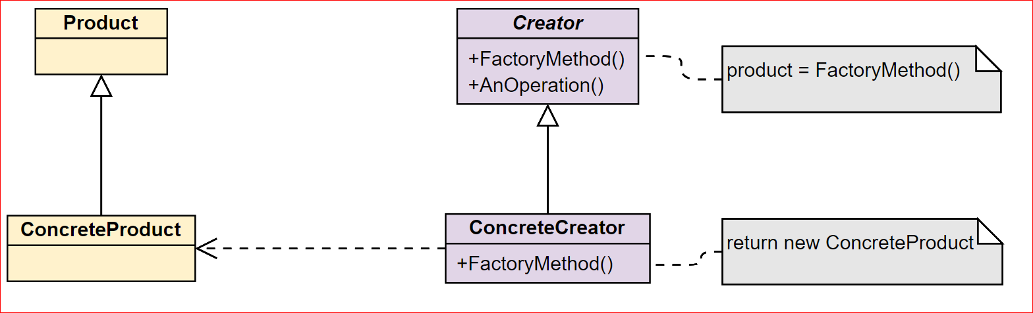
Factory Method
Define an interface for creating an object, but let subclasses decide which class to instantiate. Factory Method lets a class defer instantiation to subclasses.

Slide 25
Factory Method
Virtual Constructor
Libraries / Frameworks
Spring framework
BeanFactory
InitializingBean

Slide 26
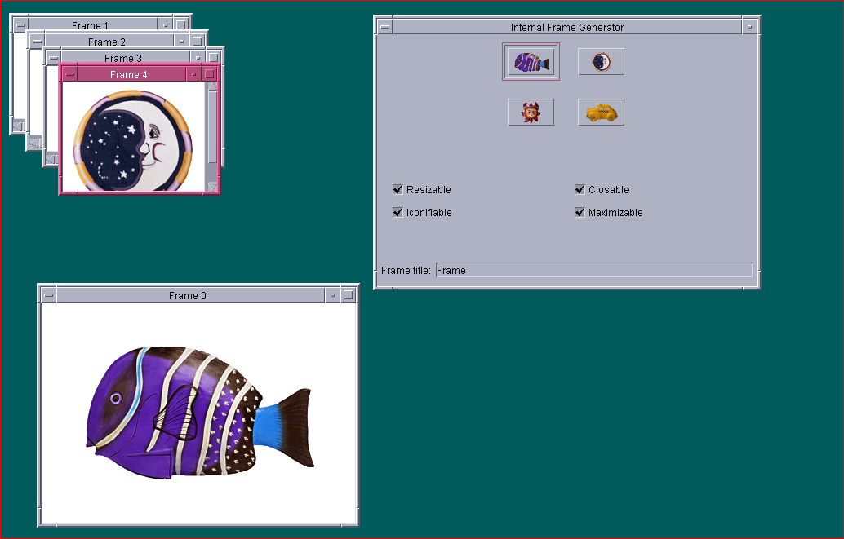
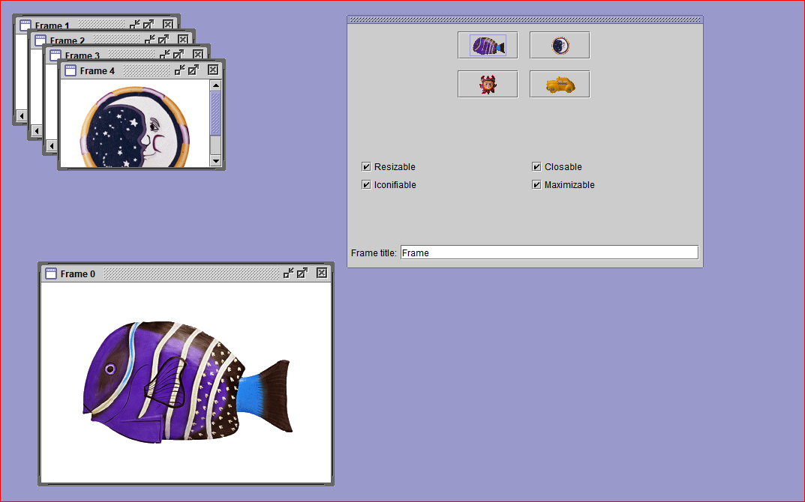
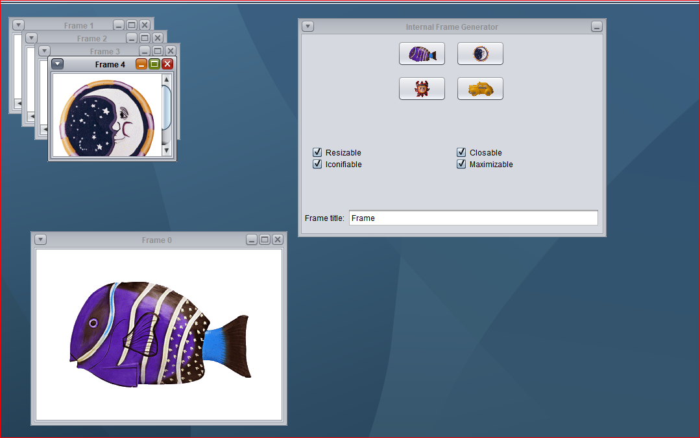
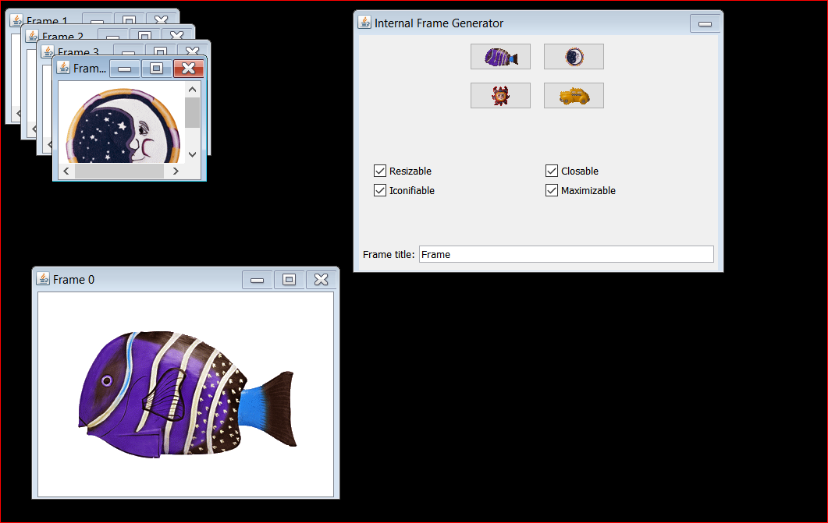
Abstract Factory
Java/Steel
Motif
Nimbus
Windows
SwingSet (JDK demos)
Your favourite?

Slide 27
Abstract Factory
GUI application framework -> Swing
Java Look and Feel
JButton -> MotifLaFJButton, NimbusLaFJButton
JList -> MotifLaFJList, NimbusLaFJList
ComponentFactory -> getButton, getList

Slide 28
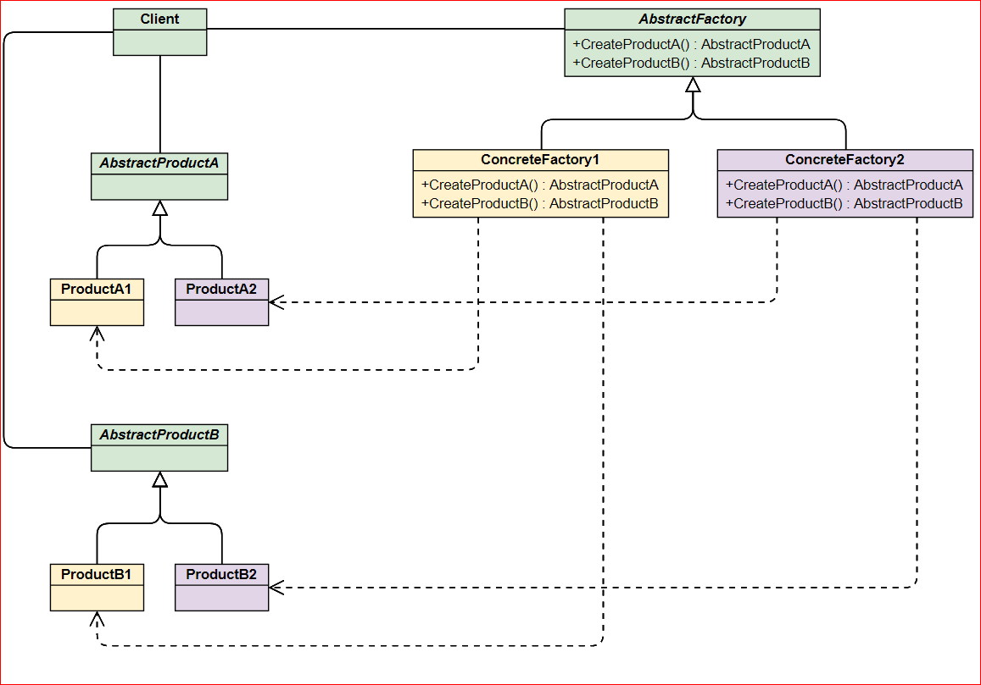
Abstract Factory
Provide an interface for creating families of related or dependent
objects without specifying their concrete classes.

Slide 29
Builder
Separate the construction of a complex object from its representation so that the same construction process can create different representations.
Complex objects are made of parts produced by other objects that need special care when being built.
An application might need a mechanism for building complex objects that is independent from the ones that make up the object.

Slide 30
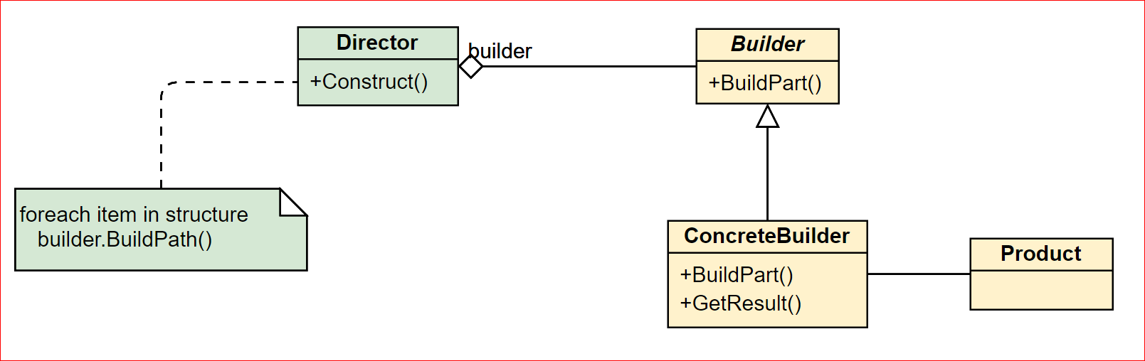
Builder
Separate the construction of a complex object from its representation so that the same construction process can create different representations.

Slide 31
Builder
vs. AbstractFactory?
JavaBeans builder / method chain
Membership.Builder.create()
.firstName(“name”)
.lastName(“last”).
.birthdate(new Date())
.build();

Slide 32
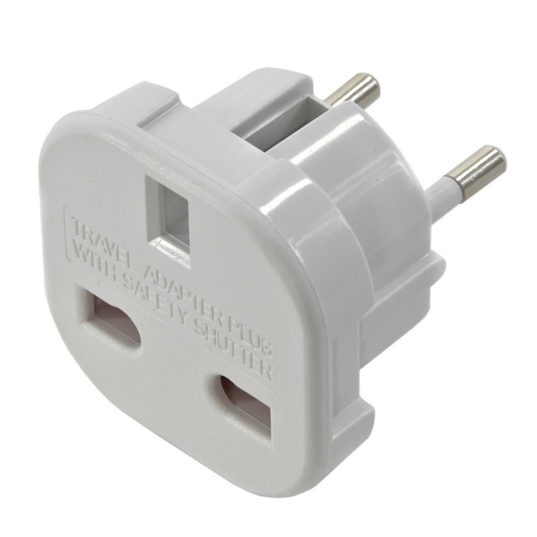
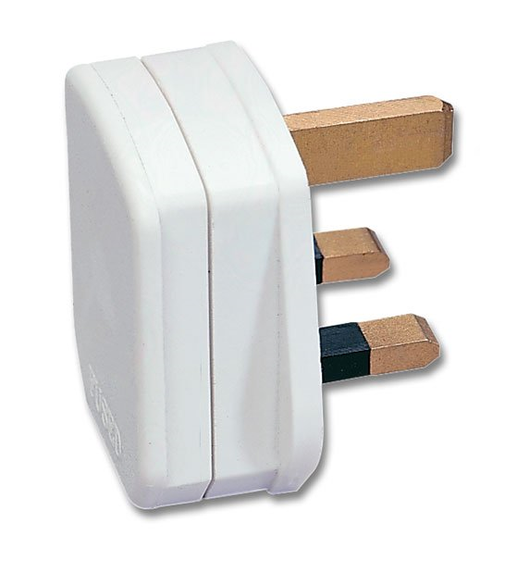
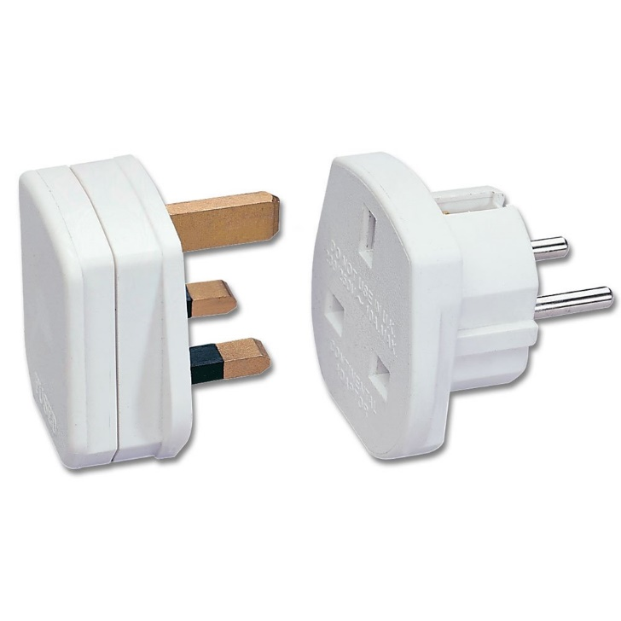
Adapter

Slide 33
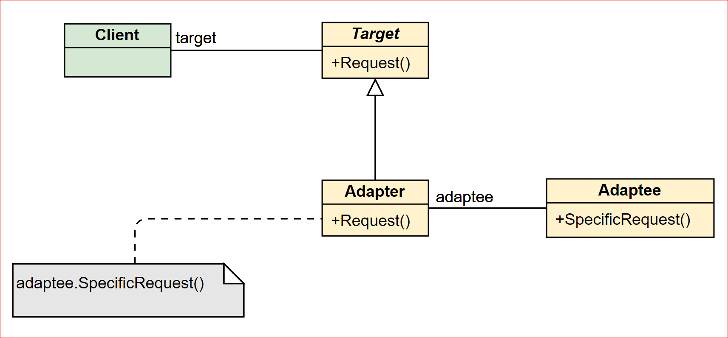
Adapter
Convert the interface of a class into another interface clients expect. Adapter lets classes work together that couldn't otherwise because of incompatible interfaces.

Slide 34
Adapter
Object Adapter / delegation
Class Adapter -> java doesn’t like it
Two-Ways Adapters
Adapter conforms to both of the adapted classes and can work in either system.
The adapted object can be used as Target in new systems dealing with Target classes or as Adaptee in other systems dealing with Adaptee classes.

Slide 35
Bridge
Remember the GOLDEN rule: Favor object composition over class inheritance.
Inheritance binds an implementation to the abstraction
It would be difficult to modify, extend, and reuse abstraction and implementation independently.

Slide 36
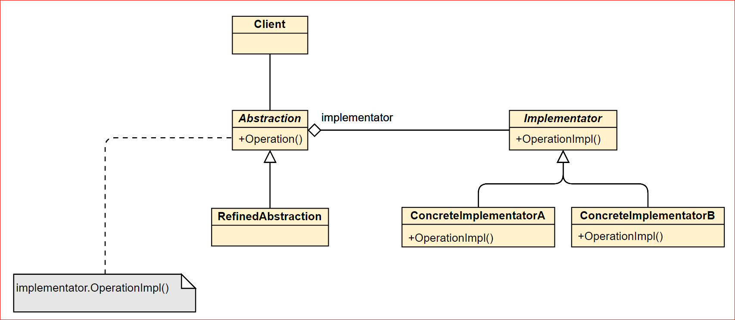
Bridge
Decouple an abstraction from its implementation so that the two can vary independently.

Slide 37
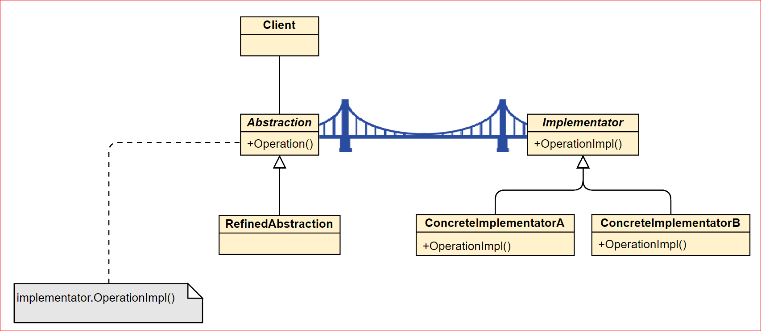
Bridge
But where is the bridge?

Slide 38
Decorator
List
FilteringList
IncrementingList
DoublingList

Slide 39
Decorator
Sometimes we want to add responsibilities to individual objects, not to an entire class.
List
DoublingList
FilteringList
IncrementingFilteringList
FilteringDoublingList
IncrementingDoublingList
IncrementingDoublingFilteringList
IncrementingDoublingFilteringList

Slide 40
Decorator
To add responsibilities to individual objects dynamically and transparently,
that is, without affecting other objects.
new Decorator1(new Decorator2(new Decorator3(new Decorator3(new List()))))
Decorator
Decorator
List
Another Decorator
Other name is: Wrapper

Slide 41
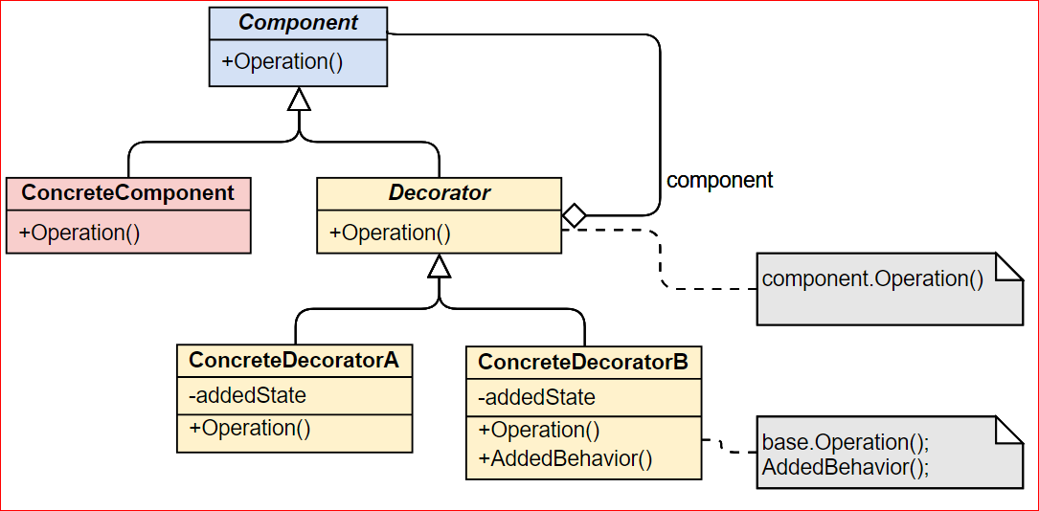
Decorator
Attach additional responsibilities to an object dynamically. Decorators provide a flexible alternative to subclassing for extending functionality.

Slide 42
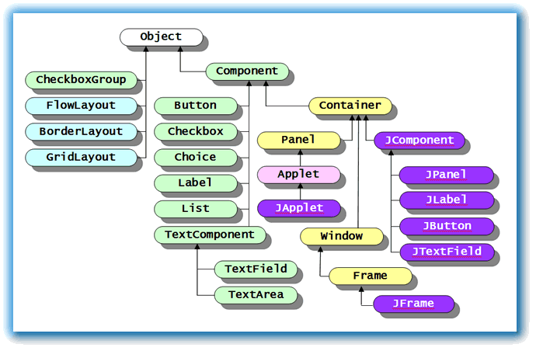
Composite
Swing Framework

Slide 43
Composite
Another simple example?
<menu>
<food>
<name attr=“”>Belgian Waffles</name>
<price>$5.95</price>
<description>
Two of our famous Belgian Waffles with plenty of real maple syrup
</description>
<calories>650</calories>
</food>
</ menu>
org.w3c.dom.Node
org.w3c.dom.NodeList

Slide 44
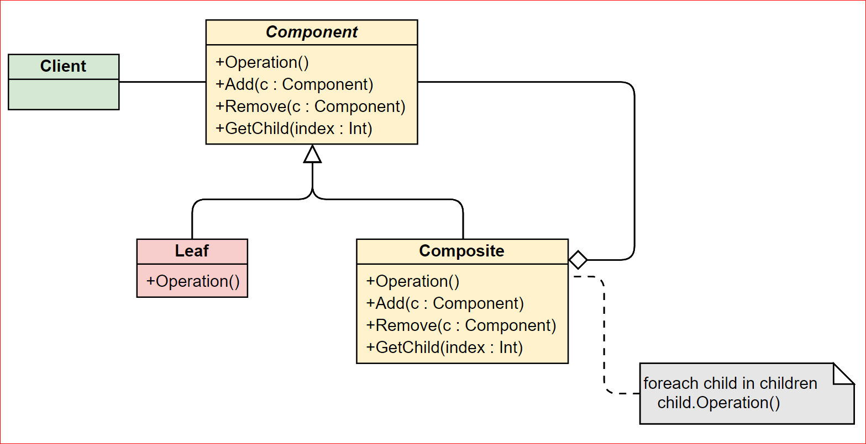
Composite
Compose objects into tree structures to represent part-whole hierarchies. Composite lets clients treat individual objects and compositions of objects uniformly.

Slide 45
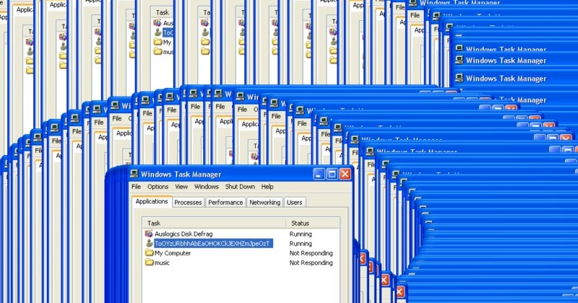
Flyweight

Slide 46
Flyweight
Use sharing to support large numbers of fine-grained objects efficiently.
Sharing of what?
State
Intrinsic state is stored (shared) in the Flyweight object.
Extrinsic state is stored or computed by client objects, and passed to the Flyweight when its operations are invoked.

Slide 47
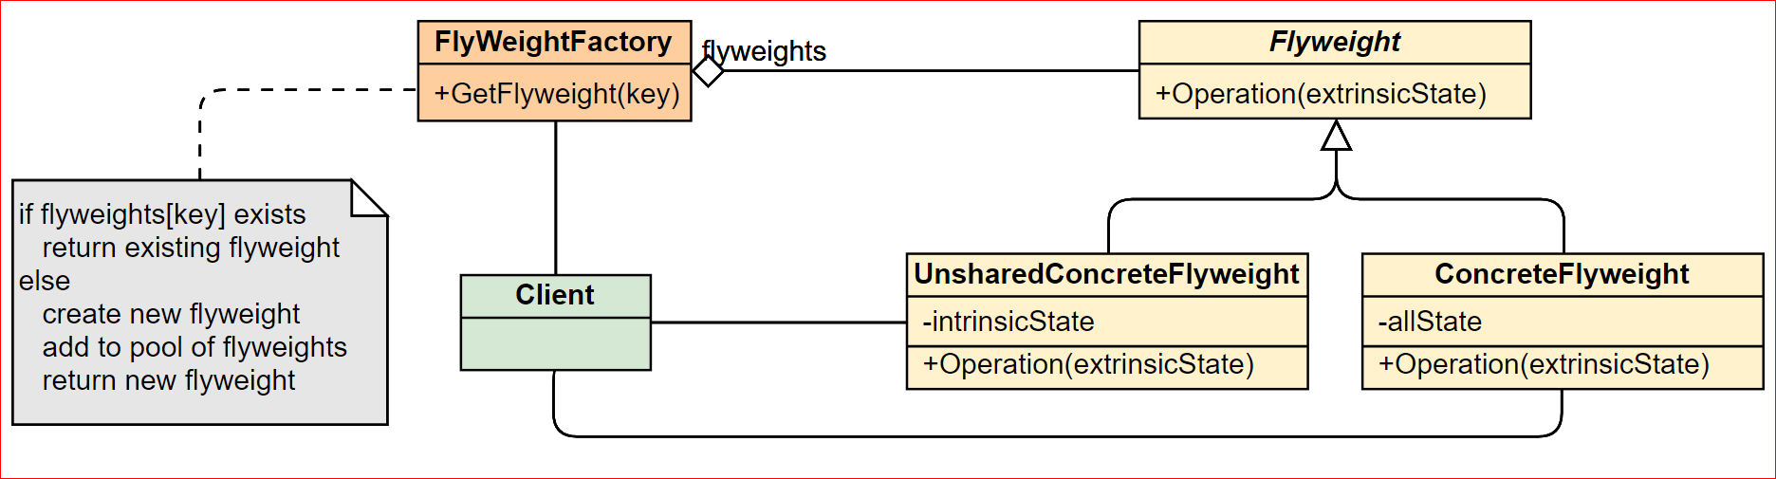
Flyweight
Flyweights are stored in and provided by a Factory's repository.
Any attributes that would make sharing impossible must be supplied by the client whenever a request is made of the Flyweight.

Slide 48
Proxy
Provide a surrogate or placeholder for another object to control access to it.
But why?
Defer the full cost of real object creation and initialization until we actually need to use it.
Add a wrapper and delegation to protect the real component from undue complexity.
Interposes additional actions when an object is accessed.

Slide 49
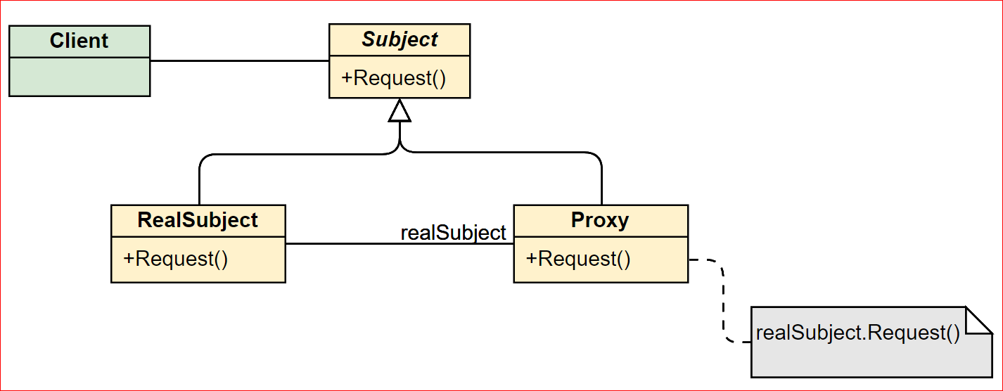
Proxy
Virtual proxy
Remote proxy -> RMI or CORBA stubs
Protective/Protection proxy
Smart proxy
vs Adapter?
vs Decorator?

Slide 50
Chain of Responsibility
Avoid coupling the sender of a request to its receiver by giving more than one object a chance to handle the request. Chain the receiving objects and pass the request along the chain until an object handles it.
Execution / Processing pipeline
Request
Client
Processing element
Processing element
Processing element
Processing element

Slide 51
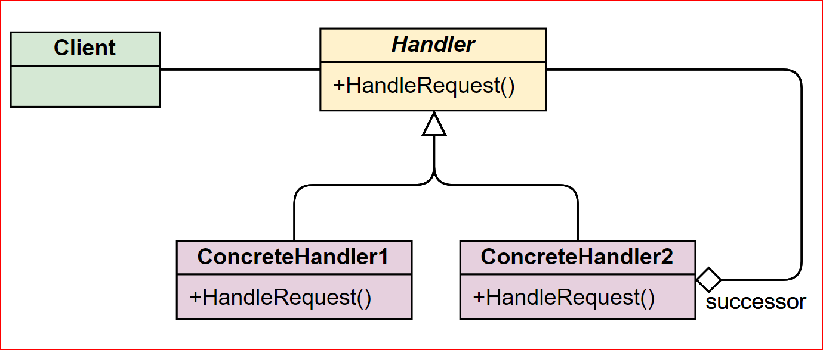
Chain of Responsibility
More than one object can handle a command
The handler is not known in advance
Broken Chain -> Force chaining ! How?

Slide 52
Command
Encapsulate a request as an object, thereby letting you parameterize clients with different requests, queue or log requests, and support undoable operations.
Issue requests without knowing the requested operation or the requesting object.
Provides the options to queue commands, undo/redo actions and other manipulations.
Decouples the object that invokes the action from the object that performs the action.

Slide 53
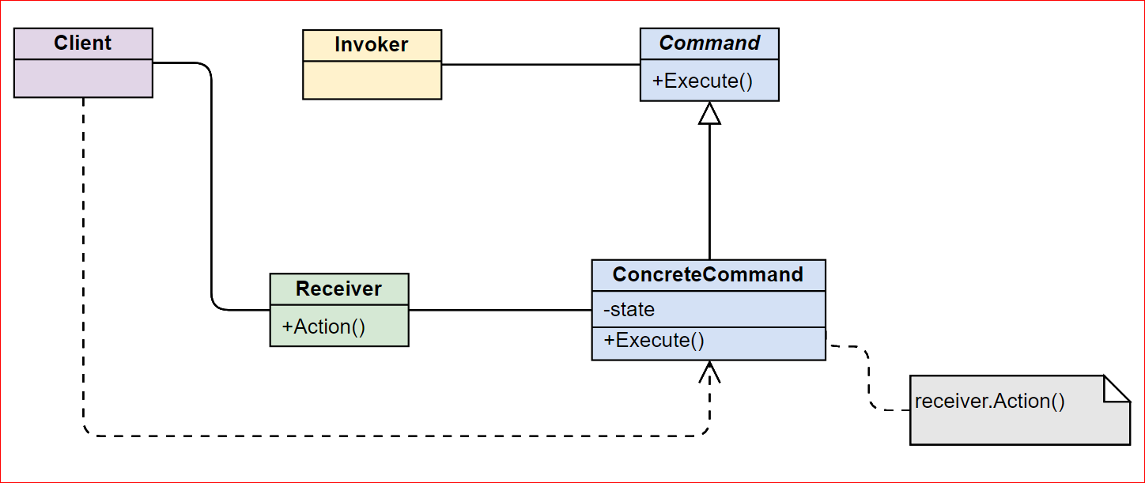
Command
Interface separation (the invoker is isolated from the receiver)
Time separation (stores a ready-to-go processing request that's to be stated later).

Slide 54
Mediator
Service
Service
Service
Service
Service
Service

Slide 55
Mediator
Service
Service
Service
Service
Service
Service
Mediator
Service
Service
Service
Service
Service
Service

Slide 56
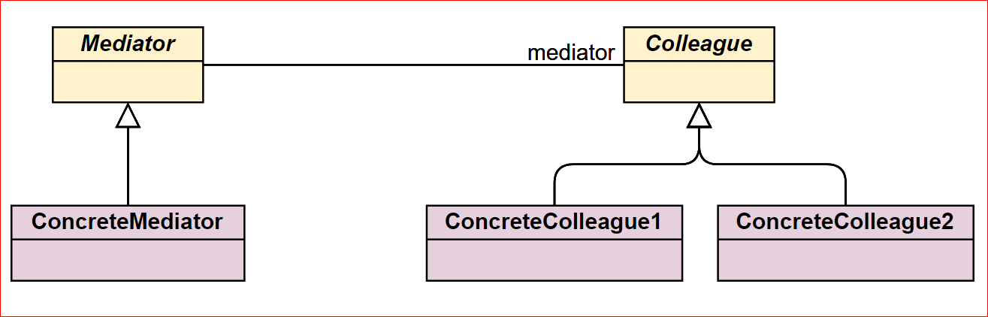
Mediator
Define an object that encapsulates how a set of objects interact. Mediator promotes loose coupling by keeping objects from referring to each other explicitly, and it lets you vary their interaction independently.

Slide 57
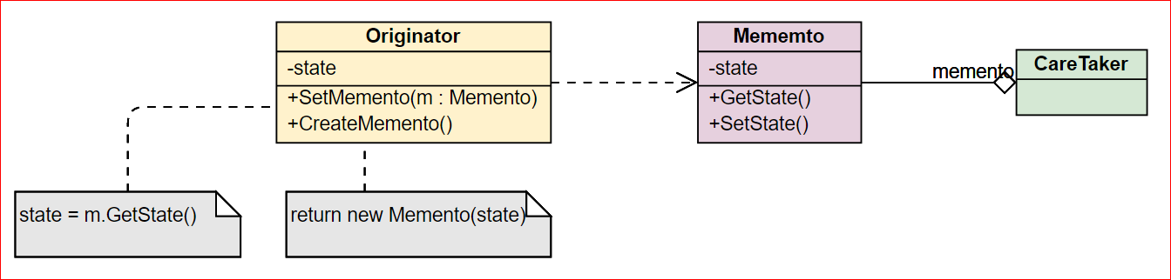
Memento
Without violating encapsulation, capture and externalize an object's internal state so that the object can be restored to this state later.
Encapsulates a "check point" capability.
Promotes undo or rollback to full object status.

Slide 58
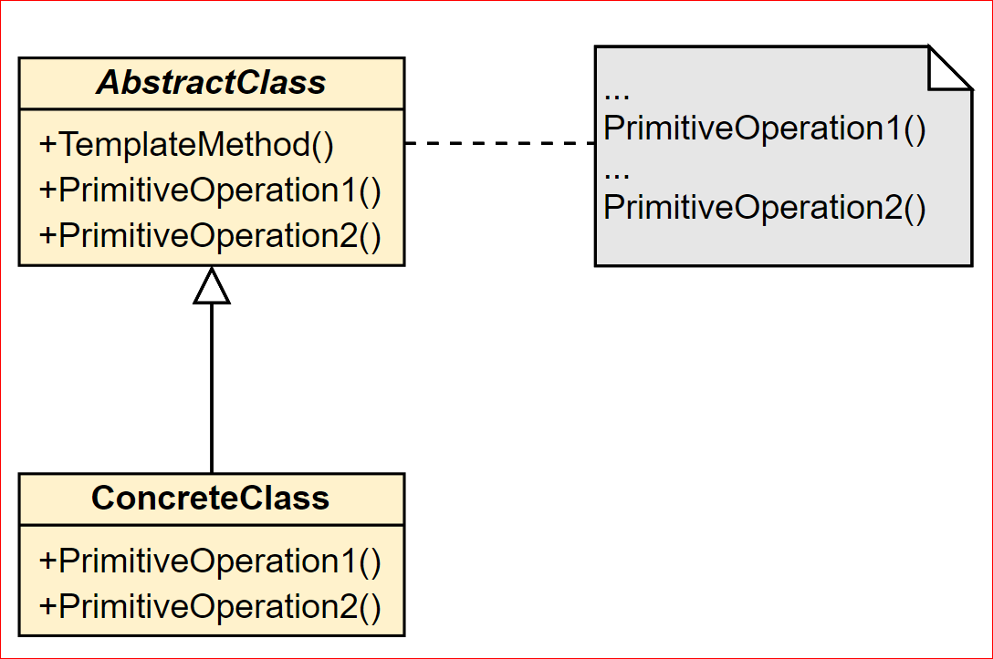
Template Method
Define the skeleton of an algorithm in an operation, deferring some steps to subclasses. Template Method lets subclasses redefine certain steps of an algorithm without changing the algorithm 's structure.

Slide 59
Template Method
Don't call us, we'll call you
Define hooks for steps that require different implementations
Wordpress hooks

Slide 60
Observer
Define a one-to-many dependency between objects so that when one object changes state, all its dependents are notified and updated automatically.
Also known as Publish/Subscribe
The subject is the publisher o f notifications. It sends out these notifications without having to know who its observers are. Any number of observers can subscribe to receive notifications.

Slide 61
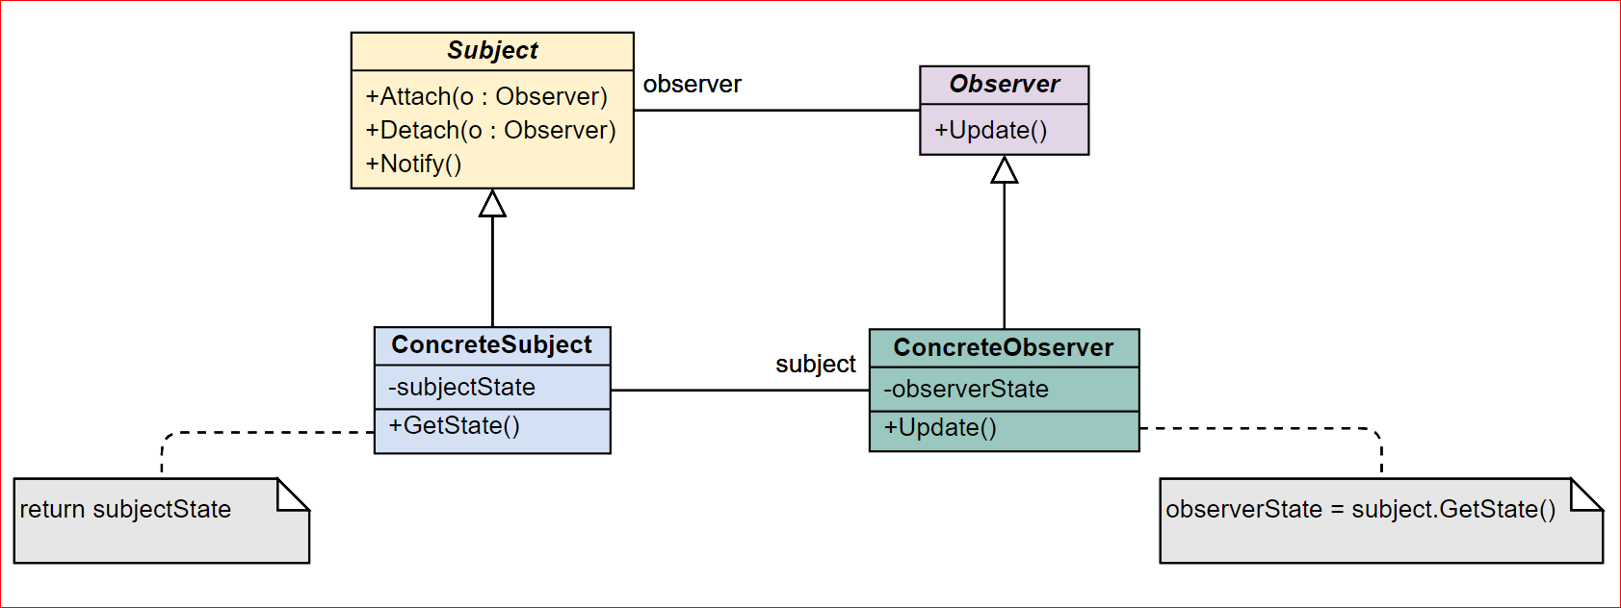
Observer
Define a one-to-many dependency between objects so that when one object changes state, all its dependents are notified and updated automatically.

Slide 62
Observer
Abstract coupling between Subject and Observer
Trigger updates.. Who?
Very frequent updates!
Making sure Subject state is self-consistent before notification.
Template Method
Notify only interested Observers

Slide 63
Observer
class Observable{
...
int state = 0;
int additionalState = 0;
public updateState(int increment){
state = state + increment;
notifyObservers();
}
...
}
class ConcreteObservable extends Observable{
...
public updateState(int increment){
super.updateState(increment); // the observers are notified
additionalState = additionalState + increment;
}
...
}

Slide 64
Observer
class Observable{
...
int state = 0;
int additionalState = 0;
public void final updateState(int increment){
doUpdateState(increment);
notifyObservers();
}
public void doUpdateState(int increment){
state = state + increment;
}
...
}
class ConcreteObservable extends Observable{
...
public doUpdateState(int increment){
additionalState = additionalState + increment;
}
...
}

Slide 65
Interpreter
Given a language, define a representation for its grammar along with an interpreter that uses the representation to interpret sentences in the language.
Map a domain to a language, the language to a grammar, and the grammar to a hierarchical object-oriented design.
Define a grammar for the language.
Map each production in the grammar to a class.
Organize the suite of classes into the structure of the Composite pattern.
GoF pattern which is not really used.

Slide 66
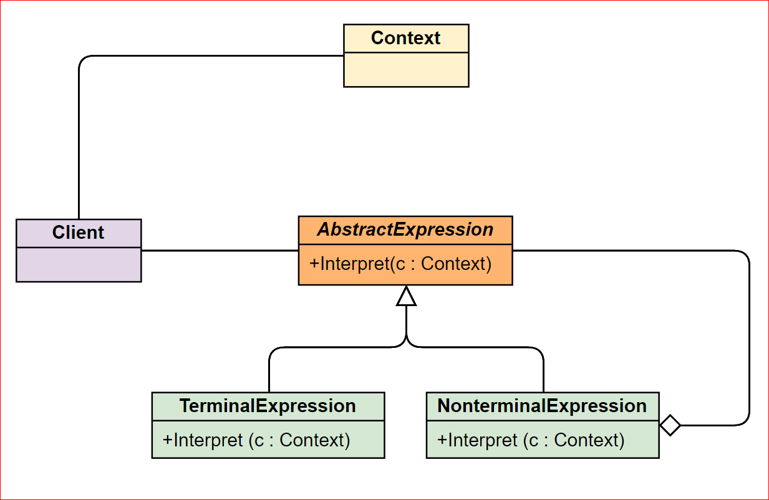
Interpreter
Given a language, define a representation for its grammar along with an interpreter that uses the representation to interpret sentences in the language.

Slide 67
State
Allow an object to alter its behavior when its internal state changes. The object will appear to change its class.
Move context’s state change out of context
Replace multiple if/else/elif statements with state transition
Represent the different "states" of the state machine as derived classes of the State base class.
Maintain the current "state" in the "context" class.
To change the state of the state machine, change the current "state" pointer.

Slide 68
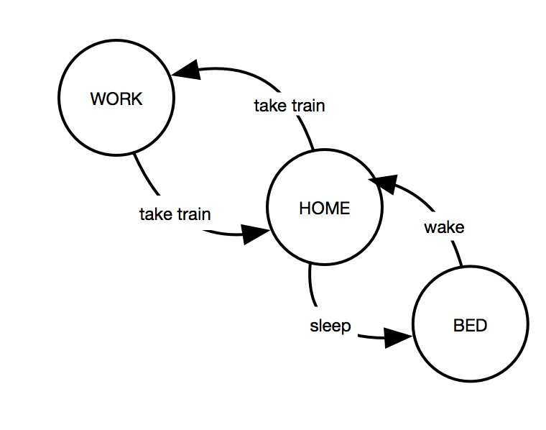
State
Allow an object to alter its behavior when its internal state changes. The object will appear to change its class.

Slide 69
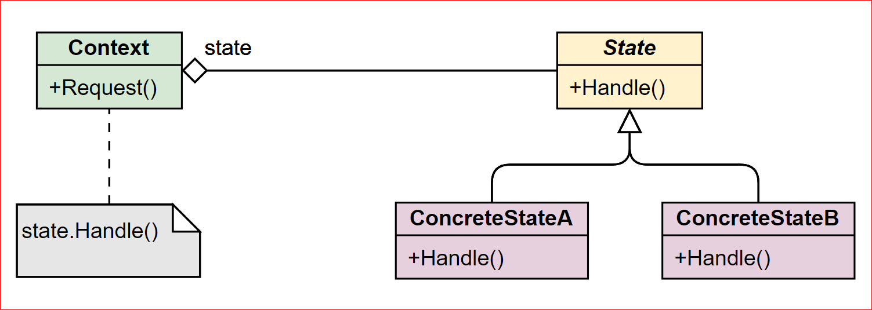
State
Allow an object to alter its behavior when its internal state changes. The object will appear to change its class.

Slide 70
Visitor
Represent an operation to be performed on the elements of an object structure. Visitor lets you define a new operation without changing the classes of the elements on which it operates.
Provides a flexible design to extend existing functionality without changing existing code.
Visitor gathers related operations and separates unrelated ones
The visitors objects can be complex objects and can maintain a context during a traversal.

Slide 71
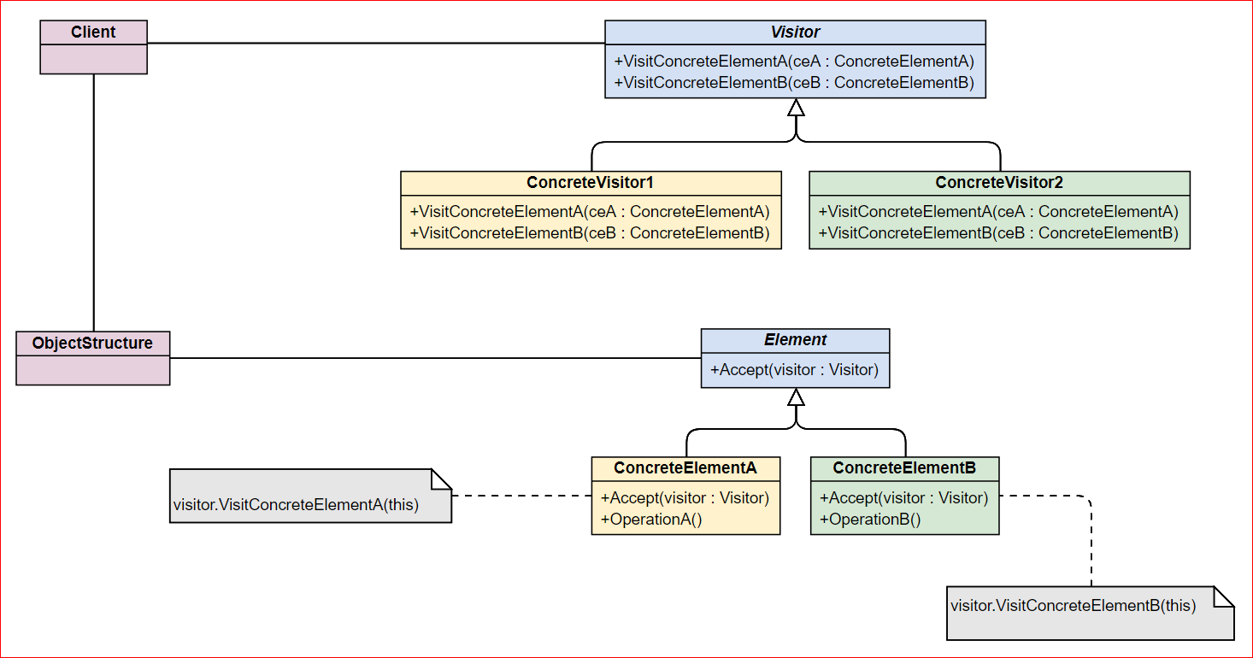
Visitor
Represent an operation to be performed on the elements of an object structure. Visitor lets you define a new operation without changing the classes of the elements on which it operates.

Slide 72
Thank you!
amadeus.com
amadeus.com/blog
You can follow us on:
AmadeusITgroup
Notes:
Backcover option 2

